Slide 1
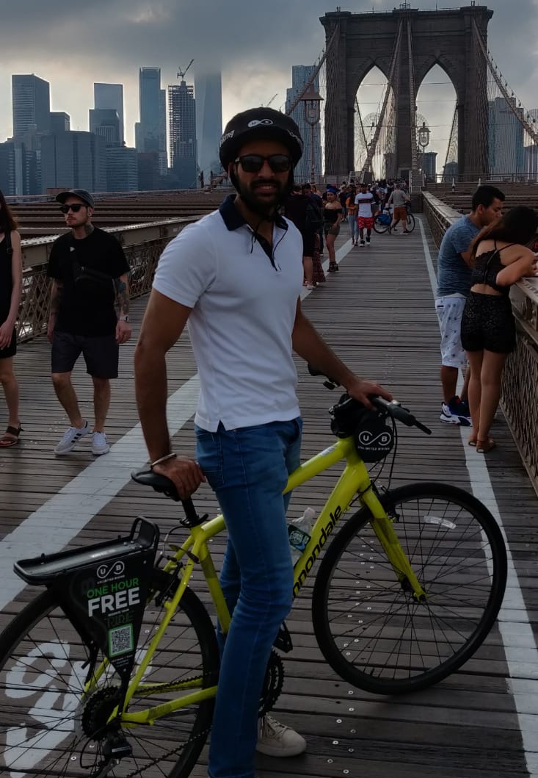
Toronto Bike Share Data
Submitted By : Amber Sidhu

Slide 2
Motivation & Summary Slide
Whenever I travel to any new metropolitan city, I love to discover the new places by renting bikes and exploring by my own using maps.
I have been in Toronto since 2018 but never got a chance to discover the city using a bike.
Questions in mind ?
Identify the data on user type ?
Location of the top 20 bike stations in Toronto ?
Location of the least used stations in Toronto and if they should be closed?

Slide 3
Questions and Data
The main task to answer the questions from previous slide is to understand the outcomes of the top 20 bike stations and the least used station i.e.
Is it possible to add more stations in the vicinity of the top 20 bike stations to cater the demand ?
Is it viable to eliminate the bike stations which are least used and move those to the areas where demand is high ?
Source of data,[Kaggle](https://www.kaggle.com/) , provided in project guidelines

Slide 4
Data Cleanup & Exploration
Download the Bike Share Data from Kaggle
Start skimming through the data (Condition of data)- Excel Format
Identify if the data is enough to answer the Research questions
Break down the tasks in different subgroups
Go through the Homework instructions and try to identify the important techniques to answer the questions
Start working on the homework and divide the questions as per time availability.

Slide 5
Continued..
Started exploring the data by opening the csv file format in pandas and importing important dependencies
Visualised the main data frame
Cleaned the data by keeping the columns important related to questions by using command dataframe[[“ ”, “ ”, “ ”]]
Cleaned the data by changing the name of columns using .rename(columns={}) command.
Used different commands like .value_counts( ), count( ) & group by to identify the main parameters

Slide 6
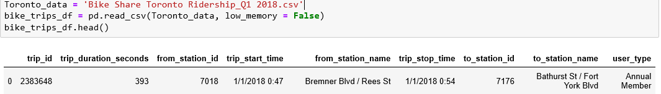
Continued..
Challenges while exploring data
Data is missing user type on gender basis and it is divided into Annual membership and casual member ship ( Annual membership – 168309, Casual membership – 10250 ) . Annual membership is 16 times higher then Casual membership. Plotting this data is not that much viable
Data is missing number of rides per station , which is very important to answer my main two questions.

Slide 7

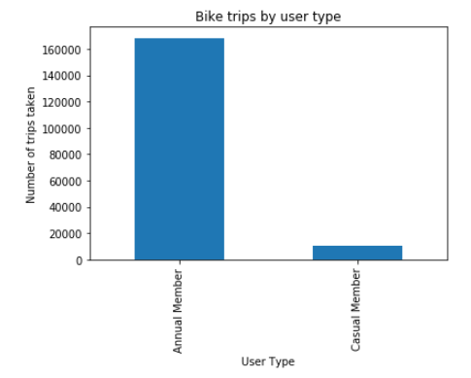
Identify the data on user type ?
Split the data by user type using .groupby(“user_type”) command
Count the data on user type by using,
User_split["user_type"].count( ) command
Chart Data
User_chart = User_trips.plot
(kind="bar", title = "Bike trips by user type")

Slide 8
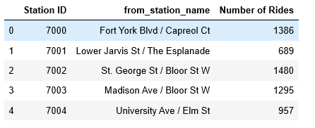
Location of the top 20 bike stations in Toronto ?
Keep the useful data from the main data frame i.e. Station ID & From_station_name
Number of rides are missing in the data frame and it can be calculated by grouping by (Station ID & from station name), sizing the data frame or using .count( ) or .count_values( ) command.

Slide 9


Continued..
Identify the max number of rides taken in order to have a ride data to identify the top 20 stations (Useful for subsequent command).
Using .loc command on numbers of rides to identify the top 20 bike station

Slide 10
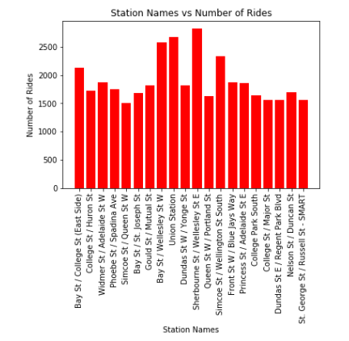
Continued..
Representing the data of top 20 stations on bar graph

Slide 11
Location of the least used stations in Toronto and if they should be closed?
Keep the useful data from the main data frame i.e. Station ID & From_station_name
Number of rides are missing in the data frame and it can be calculated by grouping by (Station ID & from station name), sizing the data frame or using .count( ) or .count_values( ) command.

Slide 12

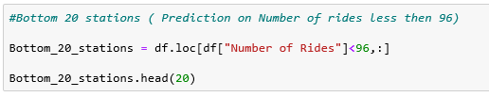
Continued..
Identify the min number of rides taken in order to have a ride data to identify the bottom 20 stations (Useful for subsequent command).
Using .loc command on numbers of rides to identify the bottom 20 bike station

Slide 13
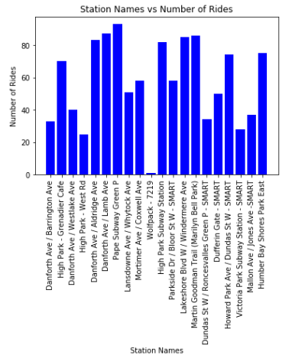
Continued..
Representing the data of bottom 20 stations on bar graph

Slide 14
Answers:
Identify the data on user type ?
Identified the data on user type. Data is divided into Annual memberships and casual memberships. ( Annual membership – 168309, Casual membership – 10250 ) . Annual membership is 16 times higher then Casual membership.
Casual memberships can be either monthly or quarterly or maybe a day pass. It is possible that price for casual membership pass is expensive as compared to Annual pass.
Discussion
I am able to identify the user type but I feel if the data is categorised on gender basis , it would have been more interesting and productive.
Could manipulate and compare the usage of bikes on gender basis and could conclude if female gender rent bikes more as compared to men counterpart either for leisure purpose or fitness.

Slide 15
Answers:
Location of the top 20 bike stations in Toronto ?
Top three locations showed here where number of rides or the usage is maximum,
Sherbourne St/Wellesley St E , Station ID-7042, with 2821 rides.
Union station, Station ID 7033, with 2677 rides.
Bay ST/Wellesley ST W, Station ID 7030, with 2587 rides.
Discussion:
The following areas are busy with lots of people commuting for work , schools, leisure purpose.
It can be visualised , if government can increase the bikes at the following stations or open other bike stations in the vicinity of the area to cater the demand

Slide 16
Answers:
Location of the least used stations in Toronto and if they should be closed?
Bottom three locations showed here where number of rides or the usage is minimum,
Wolfpack area, Station ID-7219, with 1 ride.
High Park-West Rd, Station ID-7086, with 25 rides.
Victoria Park Subway Station- SMART, Station ID-7266, with 28 rides
Discussions:
The following areas have less usage, either these are at the outskirts of the main city, people might prefer to use their personal mode of commute or public transport.

Slide 17

Continued..
The average on the number of rides for this particular data frame is 661.32
The bottom 20 locations, the min number of ride taken is 1 and the max number of ride is 93.
It can be visualised if government can take bike stations from the bottom 20 stations with least usage and move those to areas with high demand

Slide 18
Post Mortem(Difficulties)
Time constraints, I was travelling for my work trip to Europe. So I divided my tasks according to my schedule.
Many things came into my mind while working on this data frame like inserting the google map API’S and showing the maps with labels highlighting the top and bottom areas, but time restriction imposed me.

Slide 19
Open-floor Q&A

